Slide 1
Manchester Energy Aggregation Procurement Cooperative (MEAPC) Procuring For Manchester (MCEA) and Plumsted (PCEA)
Program Overview
PREPARED FOR: Manchester and Plumsted Townships
DATE: 09/30/25

Slide 2
Community Energy Aggregation: How does it work?
Implemented under the Government Energy Aggregation (GEA) law and Board of Public Utilities (BPU) rules. GEA allows a municipality to pool its residents together to create ‘purchasing power’ and obtain power supply at a better price, and under more favorable terms and conditions, than residents could obtain when shopping on their own.
Municipality must:
First pass an ordinance to establish a Community Energy Aggregation Program.
Conduct a public, competitive bid process.
Draft bid documents are submitted to the BPU and Division of Rate Counsel for review, to assure compliance with the BPU’s rules.

Slide 3
MEAPC Program: History
MCEA Round 1 contract ran from June 2017 to June 2019, resulting in $ millions in savings for participating residents.
PCEA held five rounds of contracting also saving residents $ millions, before joining with Manchester to procure jointly in their sixth round.
For Round 2 of Manchester’s program, Manchester joined with nearby Plumsted Township to form a joint purchasing group, called the Manchester Energy Aggregation Procurement Cooperative (MEAPC), to create even greater purchasing power.
In March 2019 the Township went back to market for a new contract however, market conditions were not ideal; no favorable bids were received and no award made at that time. Residents were returned to JCP&L for power supply in June 2019 when Manchester’s Round 1 contract ended.
With improved market conditions, the Township went back out to bid in June 2019. A Proposal from Constellation New Energy (Constellation), for a 24-month contract beginning October 2019 was deemed most favorable and the Township awarded a contract which ended October 2021.
Manchester and Plumsted continued with join procurement efforts in 2021 with a contract which was awarded to Energy Harbor. The 24-month contract wrapped up in December of 2023.

Slide 4
MEAPC Program: Current Bid Result
With the end of the December 2023 contract, the Township issued a Request for Proposals to solicit competitive offers from suppliers in the Fall of 2023 and then again in the Spring of 2024. Neither bid effort resulted in a sufficiently beneficial pricing to warrant the award of a new contract.
The Township went back out to bid with an RFP issued in July 2025, again joining forces with Plumsted Township.
Competitive proposals were received 8/20/25. Proposal from Constellation NewEnergy for an 18-month contract beginning November 2025 was deemed most favorable and the Township awarded a contract.
The contract price, $0.14644/kwh, is approximately 5% below the prevailing average JCP&L tariff supply price.
Contract is projected to save the typical resident about $100 over the 18-month contract term as compared to the average JCP&L BGS tariff supply price over that same period, with savings more heavily weighted during the months of October through May. For those residents residing in all-electric homes who heat with electricity, total savings will likely be greater.

Slide 5
Benefits of the MEAPC Program
Aggregate purchasing power creates competition that provides residents access to power supply at favorable prices and with more favorable terms than could be achieved by shopping on an individual basis.
Consumer Protections:
Township able to manage risk by designing the contract and bid specifications to protect consumers
Contract terms are reviewed by BPU and Rate Counsel
The price is established and known; no ‘bait and switch’ on price; no ‘market-based’ variable prices¹; no hidden fees
Length of contract is specifically defined
No fine print for customers to worry about
Contract allows residents to opt-out and switch back to JCP&L power supply or another third-party supplier at any time without penalty or fees
The contract does allow a price change price upon approval, in the event of a change law or regulation that imposes cost levels on the supplier that were unknown at the time the contract was executed, and that similarly impacts the cost of power supply under the JCP&L tariff.

Slide 6
Benefits of the MEAPC Program (cont’d)
Transparency: customers are fully informed of price, power supply content and terms and conditions.
Customer Choice: Customers may opt out at any time (at beginning prior to enrollment or any time during contract) with no exit fee
No Hassle, Same Bill: Third party supplier charge shows up on JCP&L bill- no change
Contract requires the selected supplier to provide budget billing for supply charges to those residents currently receiving budget billing from JCP&L
Local purchasing:
Currently the utility, through a wholesale auction overseen by the State, selects the contract length, supplier and the energy content for residential accounts.
MEAPC program allows Manchester to shop on behalf of the residents of the two municipalities and to customize the product and contract terms.

Slide 7
Who is Constellation NewEnergy?
Constellation NewEnergy is a retail power supplier licensed by the NJ Board of Public Utilities. With headquarters in Baltimore, its generation fleet powers more than 20 million homes and businesses and is helping to accelerate the nation’s transition to clean energy with more than 32,400 megawatts of capacity and annual output that is 90 percent carbon free.
Constellation’s family of retail businesses serves approximately two million residential, GEA, public sector and business customers, including three-fourths of the Fortune 100.
Constellation serves GEA programs nationwide and has served many New Jersey GEA programs, including previously serving Manchester’s GEA program.
For questions regarding MCEA or PCEA, to opt-out, or if you did not receive the Notification Letter and wish to become a program participant, you can reach Constellation in the following manners:
Call Toll-Free Number: 1- 844-551-8582
Email Address: vst@constellation.com
Website: https://www.constellation.com/nj-Manchester
Address: 1310 Point Street, Baltimore, Maryland 21231

Slide 8
Who is Gabel Associates?
Gabel Associates is an independent energy consulting firm and State-registered energy agent assisting the Township of Manchester with the implementation of the MEAPC program.
Gabel is not affiliated with any retail energy supplier.
Gabel works for the Township, impartially assists with the implementation of the competitive bid process for energy supply and selection of the winning bidder, and is available to answer questions from Plumsted and Manchester residents and to assist with opt-outs or opt-ins.
If you have any questions about the program, wish to opt-out or wish to become a program participant, you can contact Gabel Associates for assistance in the following manners:
Call Toll-Free at: 855-365-0770
Website: gabelassociates.com/GEA
Email to: gea-program@gabelassociates.com

Slide 9
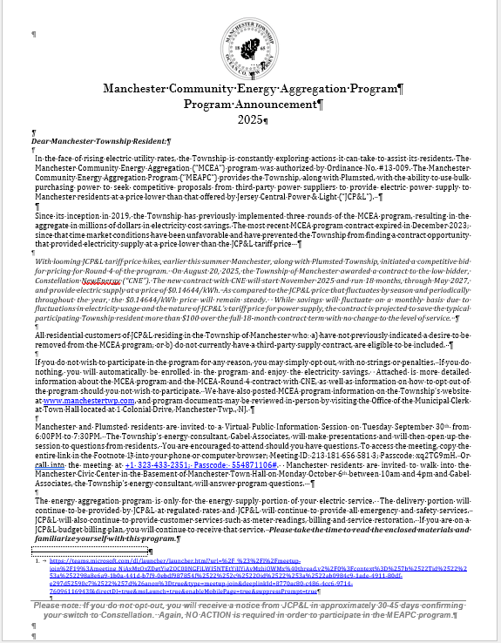
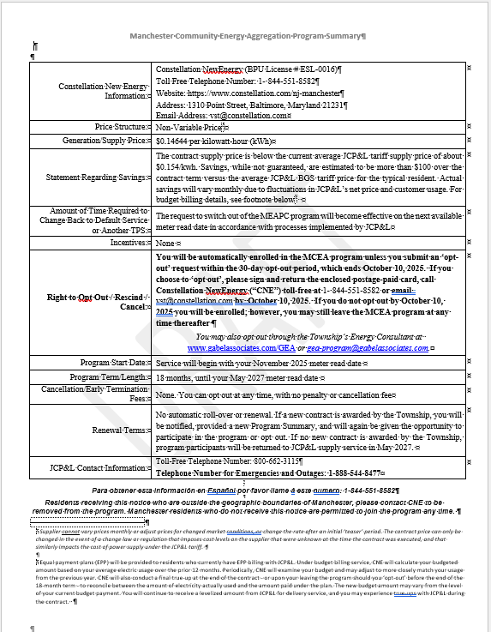
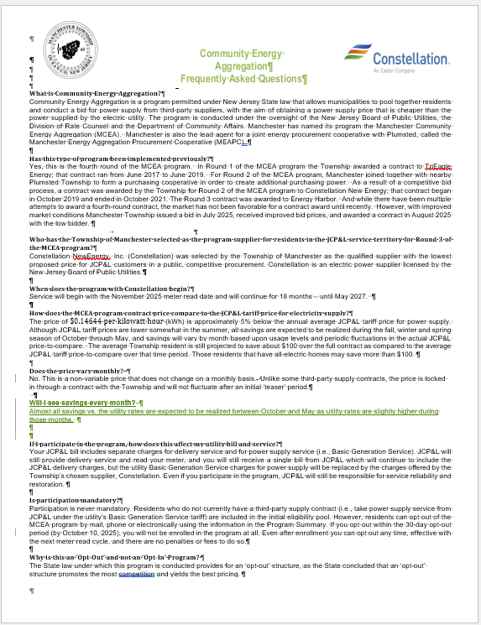
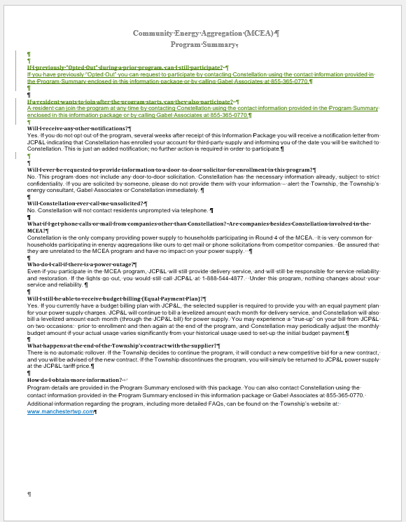
Overview of MEAPC: How does it work?
On September 10, Constellation mailed a Notification Package to all JCP&L residential customers in Township except 1) already on 3rd party supply; 2) existing solar panel system on home; 3) residents on the time-of-use tariff; 4) residents who requested to be placed on a ‘Do Not Disturb’ list.
The Notification Package includes a short introductory letter, a Program Summary table, and a 2-page FAQs. The package also includes an ‘opt-out’ card and business reply envelope.

Slide 10
Overview of MEAPC: If You Decide to Opt-Out
All residents included in the initial eligibility list have the option to ‘Opt-Out’ of the program. “Opt-out” is fast and easy.
Sign and return “opt-out” card in the mail
Call Constellation toll-free program phone number: 1-844-551-8582
E-mail Constellation MEAPC email address: vst@constellation.com
Visit Constellation’s website: : https://www.constellation.com/nj-Manchester
Visit Gabel’s website: http://www.gabelassociates.com/GEA (case sensitive)
Email Gabel’s helpdesk: gea-program@gabelassociates.com
Call Gabel’s toll-free number: 1-855-365-0770
The initial opt-out period concludes on October 10, 2025. Residents that opt-out by October 10th will not be enrolled in the program.
After October 10th 2025, Constellation will begin enrolling residents for service beginning with your November 2025 meter read date. This will be reflected on the JCP&L bill you receive in December.

Slide 11
Overview of MEAPC: What Happens After the Initial 30-Day Opt-Out Period?
If you do not opt-out by October 10th and your account is enrolled by Constellation, for the November 2025 meter read date, you will receive a separate notice from JCP&L in mid-October informing you that the supplier has enrolled your account. No further action is required if you wish to participate.
Even after the initial enrollment, if residents change their mind they may opt-out at ANY time during the contract without penalty or termination fee

Slide 12
Overview of MEAPC: Residents Removed from the Initial Pool of Eligible Customers
Residents with existing third-party supply contract, time of use meters, or existing installed solar system were excluded from the initial eligibility pool and did not receive the mailing.
These residents may still participate in the program, by deciding to ‘opt-in’ to MCEA or PCEA, however:
Customers with their own third-party supply contract are urged to first:
Compare prices per kWh
Carefully read your existing contract language to check for early termination fees (unlike the MCEA and PCEA programs which prohibits termination fees, some third-party supply contracts include provisions for early termination penalties).
Customers with solar panels urged to first review their JCP&L bills and/or discuss with their solar vendor whether their solar system does or will rely upon net-metering and banking of monthly ‘over-production.’ If so, you are likely better off remaining on JCP&L supply rather than participating in the MCEA or PCEA programs or having any other third-party supply contract.

Slide 13
MEAPC Program: Anticipated Timeline
Below you’ll find a timeline with important dates to remember:
Manchester Energy Procurement Cooperative (MEAPC)
 | Action Item | Dates
1. | Bid Award | Wednesday, August 20, 2025
2. | Opt-Out Packages Mailed | Wednesday, September 10, 2025
3. | Virtual Presentation | Tuesday September 30, 2025
4. | 30 Day Opt-Out Period Ends | Friday, October 10, 2025
5. | Enrollment Notification Letter Mailed by JCP&L | Mid-October 2025
6. | Service Commences | November 2025
7. | Service Concludes | May 2027

Slide 14
MEAPC Program: Budget Billing
Will I still be able to receive budget billing (Equal Payment Plan)?
Yes. If you currently have a budget billing plan with JCP&L, the selected supplier is required to provide you with an equal payment plan for your power supply charges.
JCP&L will continue to bill a levelized amount each month for delivery service, and Constellation will also bill a levelized amount each month (through the JCP&L bill) for power supply.
You may experience a “true-up” on your bill from JCP&L on two occasions: prior to enrollment and then again at the end of the program. This is a “true-up” of your energy supply charges.
Budget billing “true ups” do not impact participant savings.
Constellation may periodically adjust the monthly budget amount if your actual usage varies significantly from your historical usage used to set-up the initial budget payment.

Slide 15
Community Energy Aggregation Recap/Facts
All residents (except those who currently have a third-party supplier, are on a time of use rate class, or who have an installed solar system) are automatically included in the MCEA and PCEA programs, subject to an open-ended ability to opt-out.
Residents may opt out at any time without penalty and will be removed from the program. If you opt-out by October 10th you will be removed from the eligibility list and will not be enrolled. Opt-outs occurring after October 10th will take effect at the next available JCP&L meter read date.
The contract price is ‘non-variable.’ Supplier cannot just vary prices monthly or change the rate after an initial ‘teaser’ period¹.
MEAPC contract price is about 5% below the current average JCP&L tariff supply price and is expected to save the typical Township household about $100 over the 18-month contract term, with savings more heavily weighted during the months of October through May. For those residents residing in all-electric homes who heat with electricity, total savings will likely be greater.
1.The contract does allow a price change price upon approval, in the event of a change law or regulation that imposes cost levels on the supplier that were unknown at the time the contract was executed, and that similarly impacts the cost of power supply under the JCP&L tariff.

Slide 16
Community Energy Aggregation Recap/Facts (Cont’d)
JCP&L will continue to provide the delivery of power and reliability. In the case of a power outage, a resident would still reach out to JCP&L to have power restored at 1-888-544-4877.
Residents will still receive one bill for electricity; the third-party supplier’s energy cost will be included on your JCP&L bill in place of the JCP&L power supply line item.
Residents who have budget billing (Equal Payment Plan) arrangements with JCP&L will still be able to obtain budget billing for power supply charges.
There will be no effect on financial assistance received (LIHEAP, etc.) on JCP&L bills or recent $100 payments to be received from JCP&L.

Slide 17
Reading Your JCP&L Bill
Your JCP&L Bill is split up into two portions: Delivery Charges and Supply Charges.
Charges from Constellation will replace the portion of your bill that reads Basic Generation Service.
In order to opt-in or out through any one of the available means, we ask that residents have readied their Customer number, a unique identifier which allows us to enroll or unenroll an account with the supplier.
The Customer number can be found on the bottom right side of the portion of your bill which details your electricity charges.
All JCP&L Customer numbers begin with the numbers ‘08’ and have a total of 20 digits

Slide 18
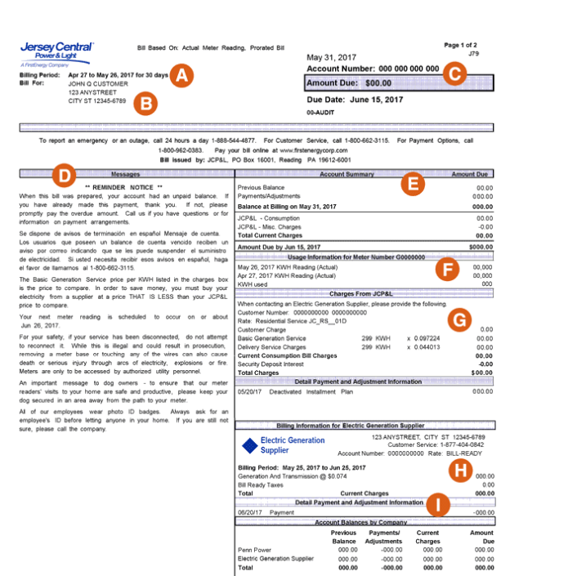
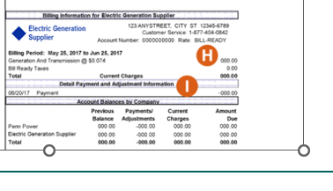
Sample JCPL Bill
Example JCP&L Bill – the current Delivery price charged by JCP&L will always appear. The charges of the third-party supplier, Constellation will appear below, replacing JCP&L Basic Generation Service charges
20 Digit Account Number Starting with “08”
JCP&L

Slide 19
Further Questions?
Contact Constellation NewEnergy: - Call toll-free at: 1-844-551-8582 - Email to: vst@constellation.com - Or visit their aggregation website at: https://www.constellation.com/nj-Manchester
Contact Gabel Associates: - Call toll-free at: 855-365-0770 - Website: http://www.gabelassociates.com/GEA - Email to: gea-program@gabelassociates.com

